Slide 1
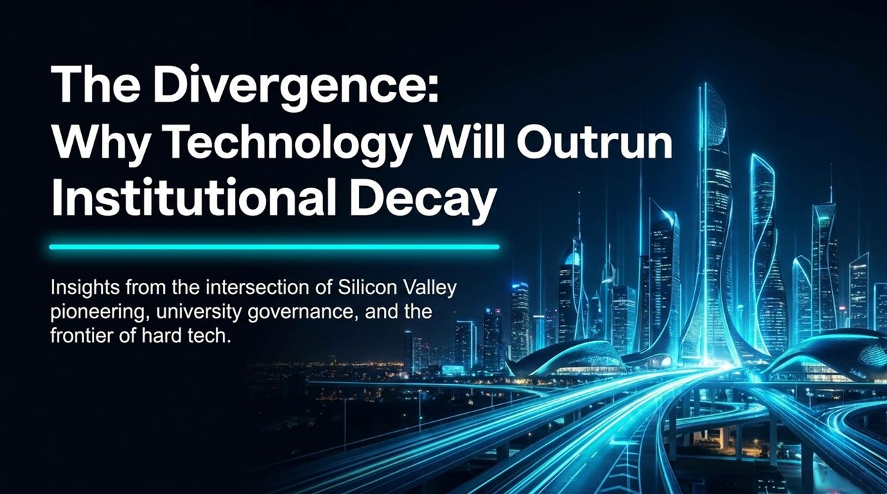
Notes:
Welcome, everyone. Today, we are exploring a core thesis that defines our current era: The Divergence—why technology will outrun institutional decay.
We find ourselves at a remarkable crossroads. On one side, we have software, hard tech, space exploration, and free-market building progressing at an exponential pace. On the other side, legacy institutions—ranging from higher education to public bureaucracies—are experiencing severe intellectual and administrative calcification.
As someone who spent decades at the center of Microsoft during the birth of the consumer internet and served 20 years on the Board of Trustees at Northwestern University, I’ve witnessed both sides of this equation firsthand.
The central message today is one of strategic optimism: while our legacy institutions are largely failing us, the builders, engineers, and risk-takers are continuously creating new pathways to bypass these broken systems and secure our future.
Ben Slivka Predicted the Internet Era. He Doesn't Buy the Hype About AI.
https://www.youtube.com/watch?v=xghaeBHamYs

Slide 2
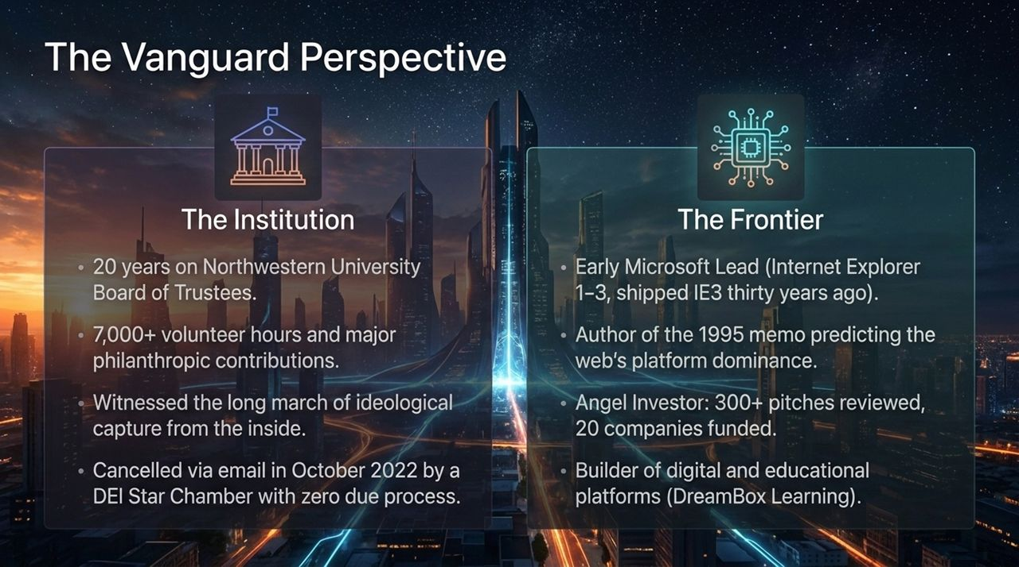
Notes:
To understand this divergence, it helps to establish where this perspective comes from—the intersection of institutional governance and the technological frontier.
On the Institutional side: I devoted 20 years to Northwestern University’s Board of Trustees, contributing over 7,000 volunteer hours and millions in philanthropy. I saw the university system from the very top. But in October 2022, I experienced the reality of modern administrative overreach when I was canceled via an email from a DEI official following baseless accusations, with zero due process or ability to defend myself.
On the Frontier side: I spent my career building. Thirty years ago, I led the team at Microsoft that shipped Internet Explorer 1, 2, and 3. In May 1995, I authored the internal memo predicting that the Web would outgrow Windows as a platform. Since leaving Microsoft, I’ve reviewed over 300 startup pitches, angel-invested in 20 companies, and built digital education platforms like DreamBox Learning.
Having sat in both the trustee boardroom and the engineering lead office, I can tell you that the principles governing these two worlds could not be more different.

Slide 3
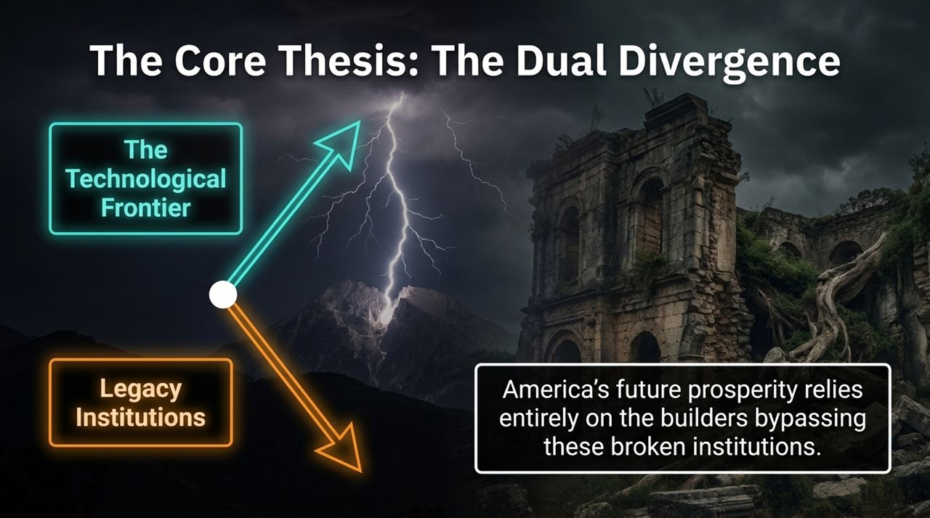
Notes:
This slide captures the foundational thesis of our discussion: The Dual Divergence.
Look at the top trajectory—The Technological Frontier. Hard tech, space logistics, energy, and open innovation operate on an exponential growth curve. This trajectory is bound to physical reality, physics, mathematical truth, capital discipline, and human curiosity. You cannot fake a rocket launch or code that doesn't run.
Now look at the bottom trajectory—Legacy Institutions. Primary and secondary education, higher ed, and administrative bureaucracies are calcifying. They are increasingly driven by ideological conformity, administrative bloat, fear of cancellation, and the abandonment of meritocracy.
The ultimate conclusion is clear: America's future prosperity and resilience will not come from fixing these legacy bureaucracies from within. It will rely almost entirely on builders creating parallel systems, bypassing the decay, and pushing technology forward.

Slide 4
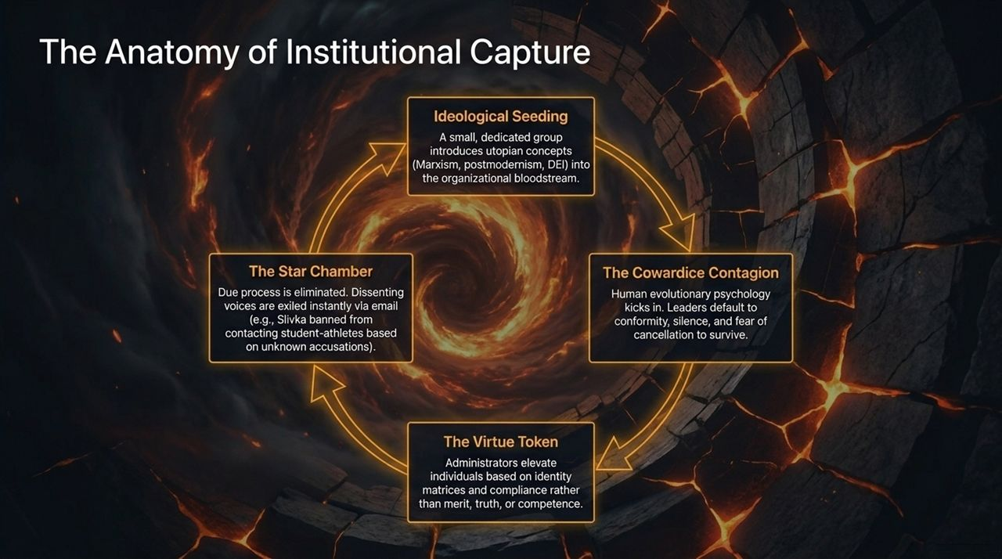
Notes:
How do healthy, world-class institutions rot from within? This process follows a predictable, cyclic framework.
It starts with Ideological Seeding. A committed minority introduces abstract, utopian theories into the organizational bloodstream.
Next comes the Cowardice Contagion. Leaders and trustees—often successful executives in their own rights—default to silence and self-preservation due to basic evolutionary psychology and fear of social ostracization.
That leads to the Virtue Token phase. Merit, competence, and rigorous truth are replaced by compliance and identity metrics.
Finally, we reach The Star Chamber. Due process is abandoned in favor of swift administrative exile for anyone who dissents. As happened in my own case at Northwestern, accusations are levied without evidence, and decisions are handed down via administrative decree.

Slide 5
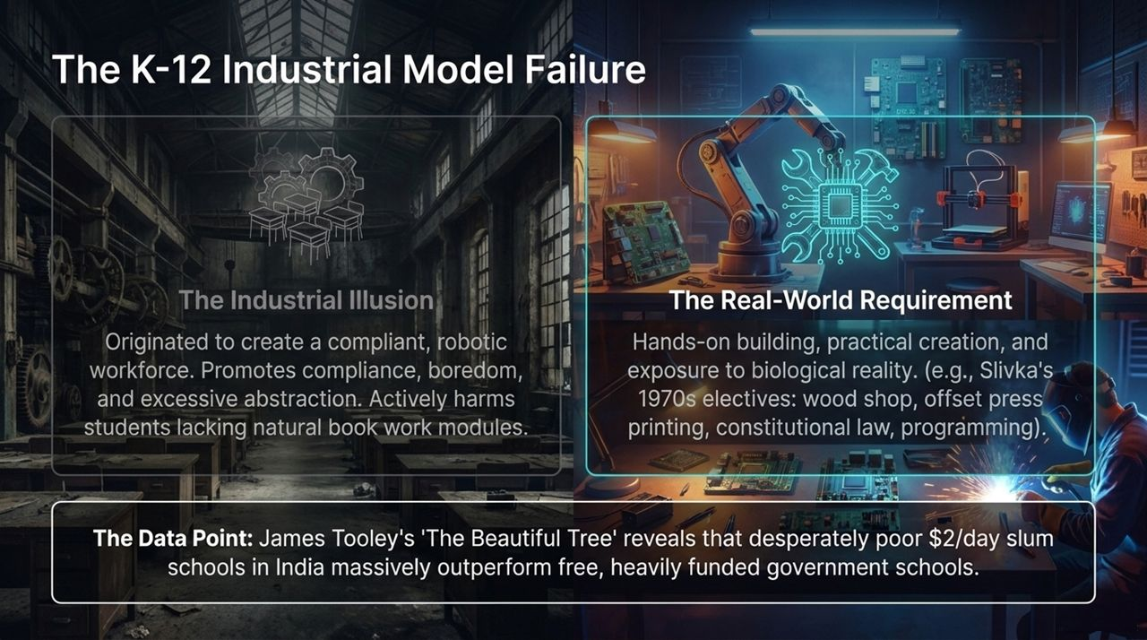
Notes:
The decay is not limited to higher education; it begins early in our K-12 educational framework.
The traditional K-12 system is a artifact of the Industrial Revolution designed to train compliant factory workers. It relies on sitting at desks, abstract bookwork, and standardized compliance. For many children, especially those who learn by doing, this model breeds boredom and suppresses innate curiosity.
What young people actually need is hands-on building, practical creation, and real-world feedback. When I was growing up in the 1970s, electives like wood shop, offset printing, constitutional law, and computer programming provided direct exposure to tangible skills.
The data confirms this failure. In The Beautiful Tree, James Tooley documents how low-cost, $2-a-day private slum schools in India significantly outperform heavily funded, free government-run schools. Money and bureaucratic administration are not substitutes for accountability, parent involvement, and practical focus.

Slide 6
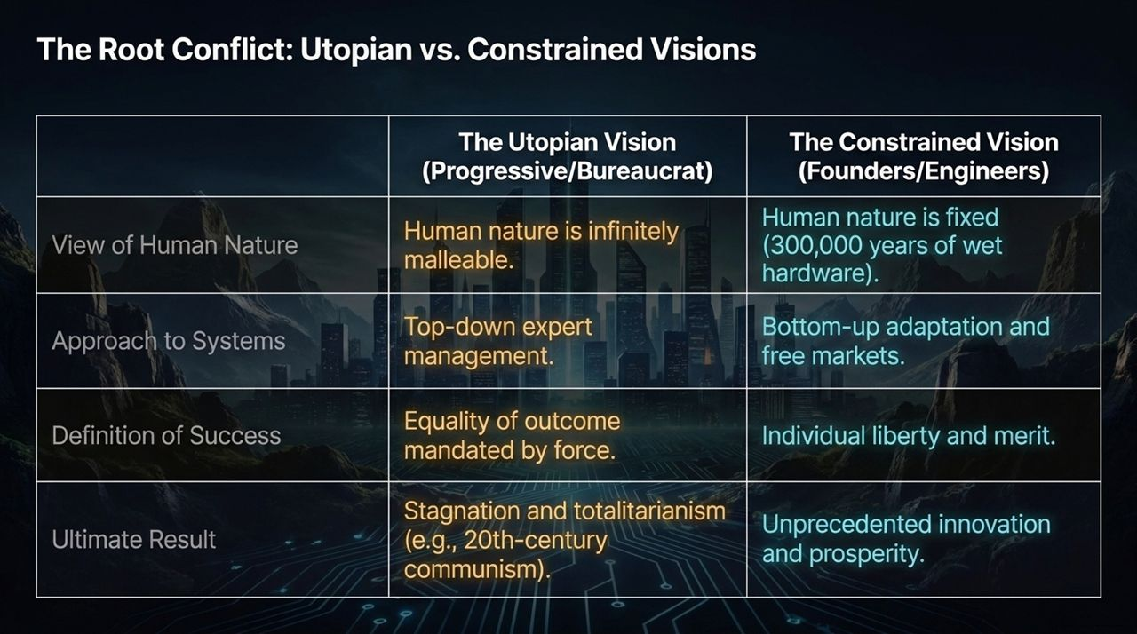
Notes:
To understand why institutions fail while engineering succeeds, we must examine their underlying philosophical assumptions. This maps to Thomas Sowell's distinction between the Utopian (Unconstrained) Vision and the Constrained Vision.
View of Human Nature: The Utopian vision treats human nature as malleable clay that can be remolded through top-down policy. The Constrained vision recognizes human nature as fixed—300,000 years of evolved biological hardware that comes with innate incentives, flaws, and trade-offs.
Approach to Systems: Utopians rely on centralized expert management. Builders and engineers rely on bottom-up adaptation, trial-and-error, free markets, and feedback loops.
Definition of Success: Bureaucracies focus on mandated equality of outcomes. Engineers and founders focus on individual liberty, merit, and functional output.
When top-down systems ignore physical reality and human nature, the result is stagnation. When systems respect physics and human nature, the result is unprecedented progress.

Slide 7
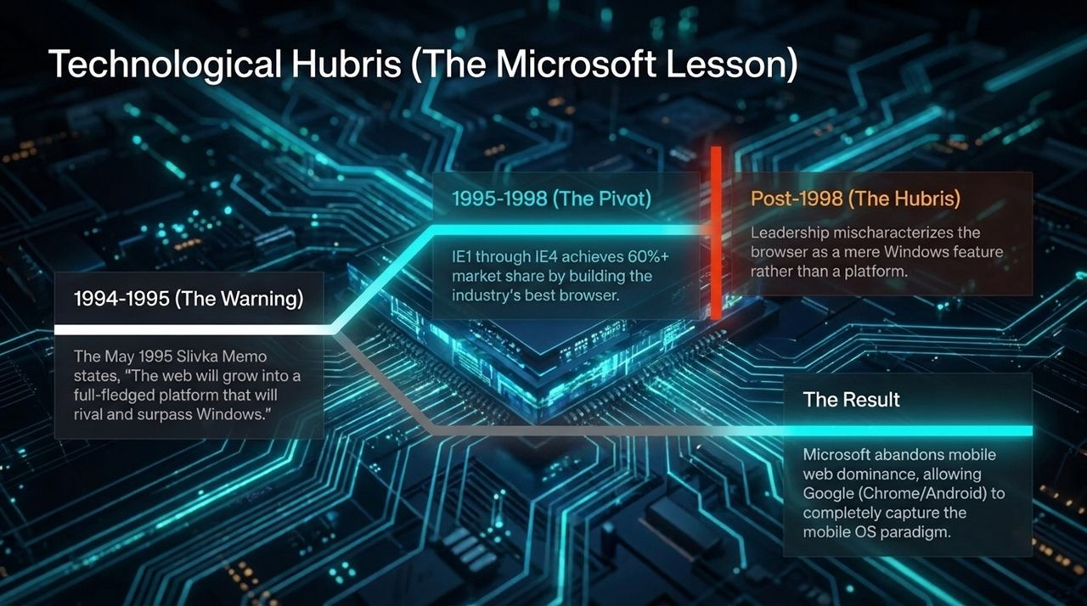
Notes:
Institutional failure isn't exclusive to universities and government—large corporations fall into the exact same traps when they prioritize bureaucracy over real-world shifts.
Look at Microsoft’s trajectory in the 1990s:
In 1995, I wrote the memo warning that the Web would supersede Windows as the dominant platform.
Between 1995 and 1998, Microsoft pivoted aggressively. We built IE1 through IE4, securing over 60% market share by building superior software.
But post-1998, organizational hubris set in. Leadership began viewing the browser merely as a protective feature for Windows rather than an evolving platform of its own.
By protecting legacy monopolies instead of pursuing the frontier, Microsoft missed the mobile web transformation, handing dominance to Google’s Chrome and Android. Tech incumbents are always vulnerable to calcification if they stop respecting fundamental shifts.

Slide 8
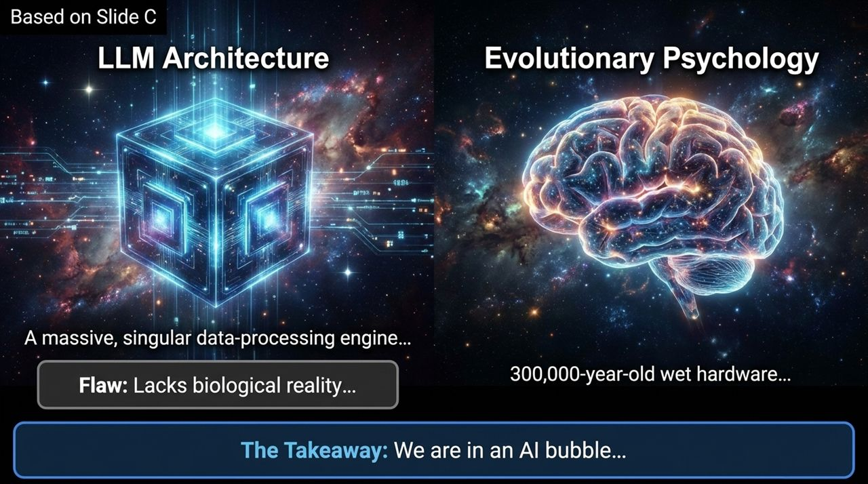
Notes:
Today, the technological world is captivated by Artificial Intelligence, but we need an engineering reality check on what Large Language Models actually are.
LLM Architecture: An LLM is a massive data-synthesis engine. It excels at pattern recognition, statistical prediction, and generating text. However, it lacks grounding in physical reality. It cannot genuinely reason about time, it frequently hallucinates, and its thermodynamic energy costs are immense.
Human Cognition: The human brain represents 300,000 years of biological evolution—wet hardware composed of over 100 specialized, energy-efficient modules for spatial reasoning, social interaction, and executive function.
We are currently in an AI hype bubble driven by confusing text synthesis with general intelligence. LLMs are incredibly useful tools for productivity, but they are not conscious, autonomous, or self-correcting AGI.

Slide 9
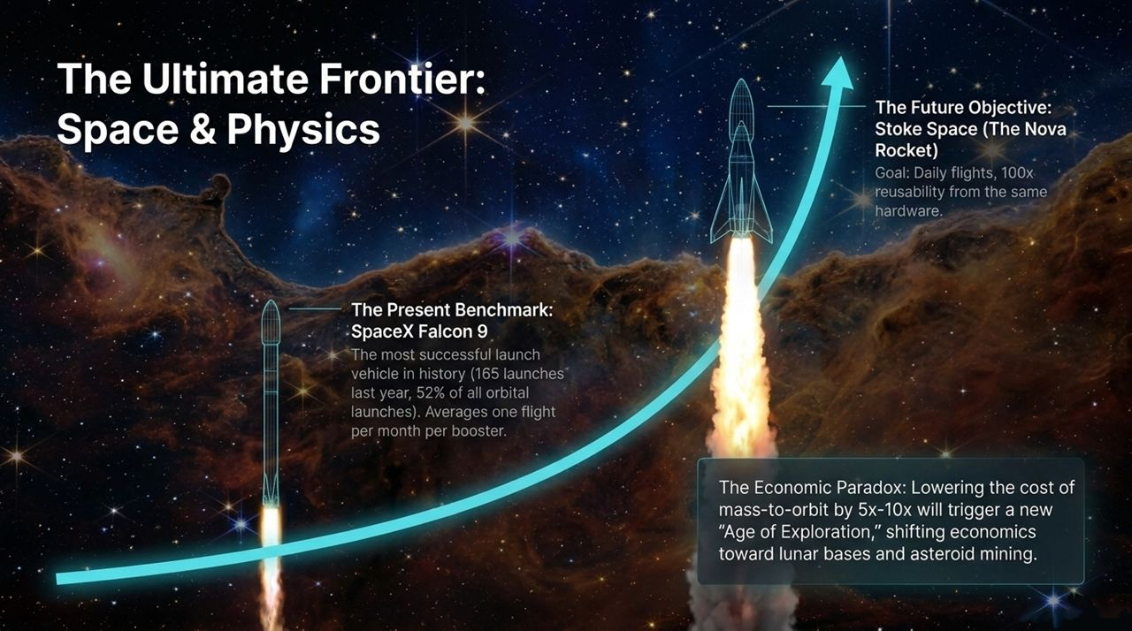
Notes:
If software is experiencing hype, hard tech and space logistics represent the truest expression of the frontier. Space forces complete alignment with physics—there is no room for administrative posturing.
The Present Benchmark: SpaceX’s Falcon 9 transformed orbital economics, executing 165 launches in a single year and accounting for over half of all global orbital launches.
The Future Objective: Companies like Stoke Space with their Nova rocket are aiming for full, 100x rapid reusability with daily launch turnarounds.
The Economic Impact: Dropping mass-to-orbit costs by another factor of 5x to 10x will unlock an era of space logistics, enabling permanent lunar development, orbital manufacturing, and resource acquisition. This is where real-world building outpaces institutional drag.

Slide 10
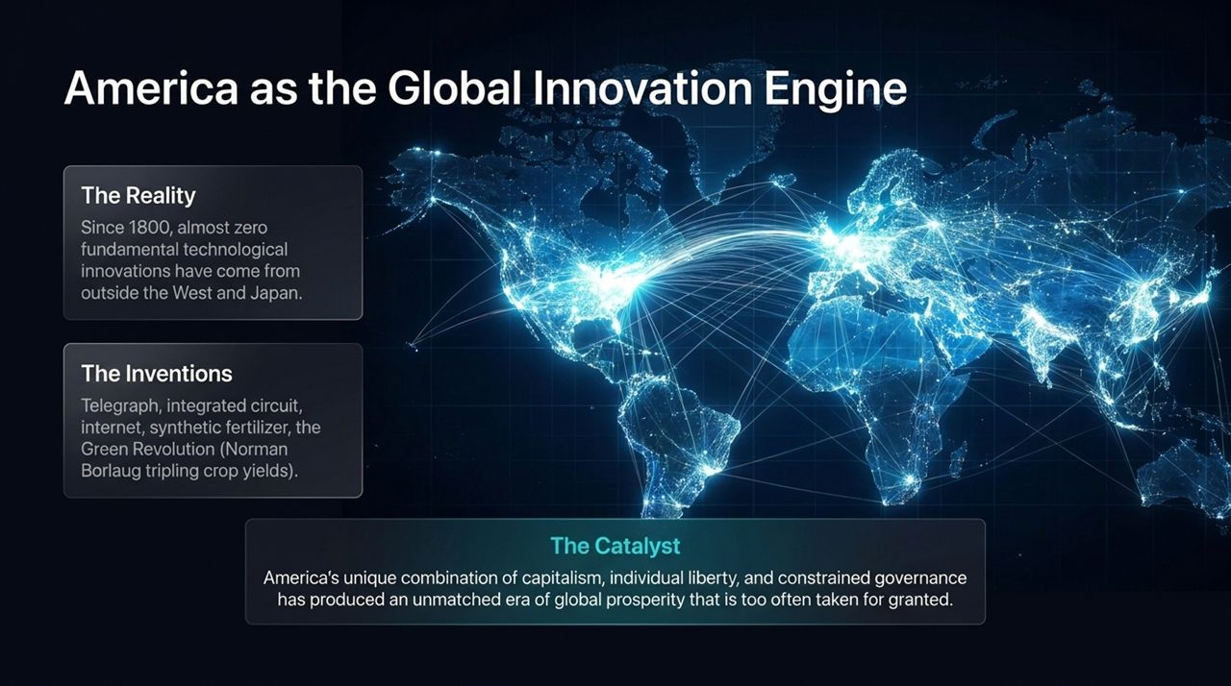
Notes:
It is easy to take modern progress for granted, but a historical perspective demonstrates how unique America's innovation engine is.
Since 1800, virtually every fundamental technological breakthrough—from the telegraph and transistor to synthetic fertilizer, the Green Revolution, and the internet—originated in the West, Japan, and primarily the United States.
This concentration of breakthroughs did not happen by accident. It was catalyzed by a unique cultural formula: free enterprise, personal liberty, rule of law, and constrained governance.
Protecting this engine requires defending the culture of building against ideological overreach that seeks to undermine merit and truth.

Slide 11
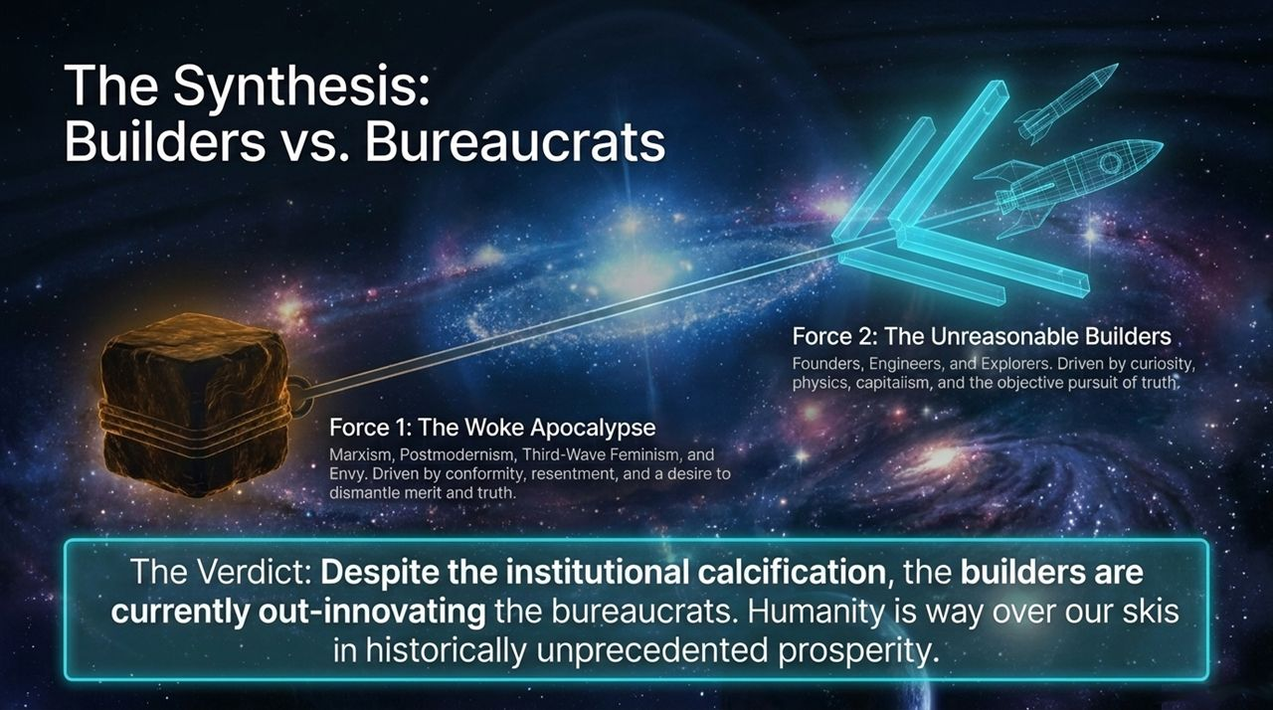
Notes:
Synthesizing these forces brings us to the core conflict defining our society today: Builders vs. Bureaucrats.
On one side is The Bureaucratic Force: Driven by ideological dogmatism, social enforcement, and resentment, this force prioritizes administrative control over objective performance.
On the other side is The Builder Force: Driven by founders, software engineers, and hard-tech pioneers who respect physics, capitalism, and real-world problem solving.
The Verdict: Despite the decay of legacy institutions, the builders are winning. Human innovation continues to move faster than bureaucratic capture, maintaining extraordinary levels of global prosperity and technological capacity.

Slide 12
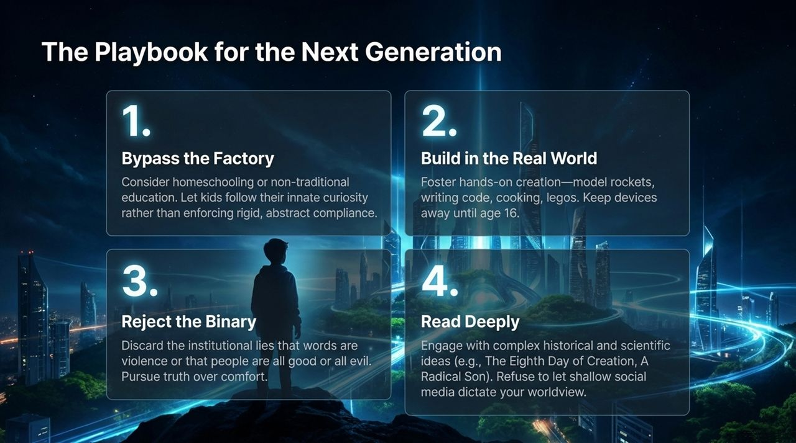
Notes:
How do we equip the next generation to navigate this environment? We need a clear, actionable playbook:
1. Bypass the Factory: Seek non-traditional, direct learning models. Encourage self-directed learning and curiosity over rigid, standardized schooling.
2. Build in the Real World: Prioritize physical and tangible skills. Encourage children to program, build hardware, work with their hands, and delay personal smartphone exposure to foster real-world social development.
3. Reject Ideological Binaries: Reject the false idea that words equal violence or that complex human issues fit into simplistic political camps. Prioritize intellectual integrity over social comfort.
4. Read Deeply: Encourage deep reading of history, science, and biography. Grounding in deep literature provides immunity against shallow, short-term outrage cycles.

Slide 13
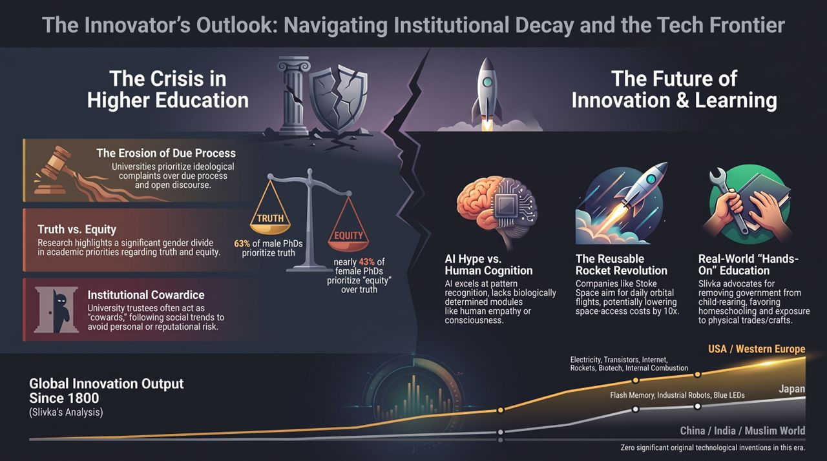
Notes:
To conclude, let’s summarize the key takeaways of The Innovator's Outlook:
First, recognize the Higher Education Crisis for what it is. The loss of due process and the shift from truth-seeking to ideological compliance have eroded institutional trust.
Second, maintain a grounded perspective on Emerging Tech. Use AI tools for synthesis, but recognize that hard tech, energy, and physical logistics remain the true drivers of human progress.
Third, double down on Practical, Real-World Education. Empower young people to solve real problems using math, physics, software, and hands-on craftsmanship.
Ultimately, institutions may decay, but the human impulse to explore, create, and build remains unbroken. By focusing on truth, merit, and hard technology, the builders will continue to lead the way forward.
Ben Slivka Predicted the Internet Era. He Doesn't Buy the Hype About AI.
https://www.youtube.com/watch?v=xghaeBHamYs

